Slide 1
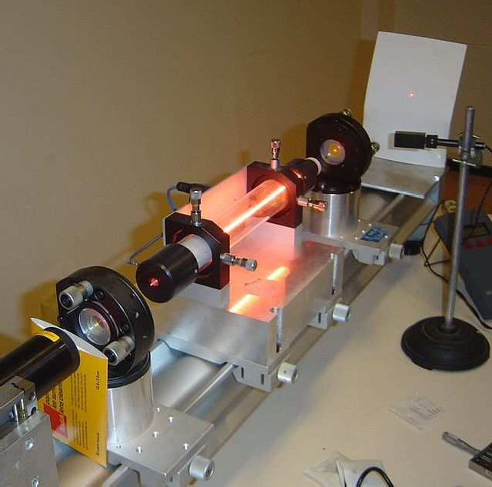
LASERS

Slide 2
Outline
LASER
Incoherent Light
Coherent Light
Atomic Interactions Related to LASER
Induced Absorption
Spontaneous Emission
Stimulated Emission
Population Inversion and Optical Pumping
Components of Laser Devices
Principle of Laser
Type of Laser
Laser Light Characteristics
Laser Applications
Holography

Slide 3

LASER
LASER stands for ‘Light Amplification by Stimulated Emission of Radiation’
Laser is a very intense, concentrated, highly parallel and monochromatic beam of light.
Coherence is very important property of Laser.
Incoherent Light:
The light emitted from the Sun or other ordinary light sources such as tungsten filament and fluorescent tube lights is spread over a wide range of frequencies.
For example: Sunlight is spread over Infra Red, Visible light and Ultra Violet
spectrum. So, the amount of energy available at a particular frequency is
very less and hence less intense.
Such light is irregular and mixed of different frequencies, directions and durations, and is incoherent.
Incoherent light is due to spontaneous and random emission of photons by
the atoms in excited state. These photons will not be in phase with each other.
Incoherent Light

Slide 4

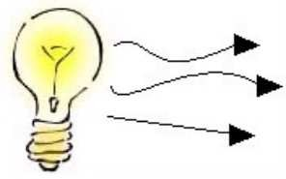
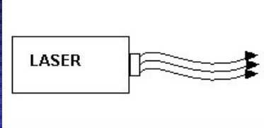
Coherent Light:
Coherent light is uniform in frequency, amplitude, continuity and constant initial phase difference.
Coherent beam of light is obtained due to stimulated emission of photons from the atoms jumping from meta-stable state to lower energy state.
Coherent Light
Incandescent Vs Laser Light
Many Wavelengths
Multidirectional
Incoherent
Monocromatic
Directional
Coherent

Slide 5
Various Atomic Interactions Related to LASER:
a) Induced Absorption: Or Absorption of Radiation:
Photons of suitable size (energy) are supplied to the atoms in the ground state. These atoms absorb the supplied energy and go to the excited or higher energy state. If E₁ and E₂ are energies of ground state (lower energy) and excited state (higher energy), then the frequency of required photon for absorption is
ν =
E₂ – E₁
where ‘h’ is Planck’s constant
h
Atom
E₂
E₂
Atom
Before absorption
E₁
hν
E₁
After absorption

Slide 6
b) Spontaneous Emission:
An excited atom can stay in the higher energy state only for the time of 10⁻⁸ s. After this time, it returns back to the lower energy state by emitting a photon of energy hν = E₂ – E₁. This emission is called ‘spontaneous emission’.
During spontaneous emission, photons are emitted randomly and hence they will not be in phase with each other. Therefore, the beam of light emitted is incoherent.
Atom
E₂
E₁
Before emission
E₂
hν
Atom After emission
E₁

Slide 7
c) Stimulated Emission:
When photon of suitable size (energy) is showered (made to fall) on an excited atom in the higher energy state, the atom falls back to the ground state by emitting a photon of energy hν = E₂ – E₁ which is in phase with the stimulating (incident) photon.
Thus, it results in the appearance of one additional photon. called ‘stimulated or induced emission’.
Atom
This process is
E₂
hν
E₁
Before emission
E₂
hν
hν
hν
Atom After emission
E₁

Slide 8


Absorption of Radiation
E
2
E = E + h ν
2 1
E - E = ΔE = h ν
2 1
E
1
The probability of occurrence of this absorption from state 1 to state 2 is proportional to the energy density u(ν) of the radiation
P₁₂ = B₁₂ u(ν)
Where Proportionality constant B₁₂ is known as Einstein coefficient of absorption of radiation

Slide 9

Spontaneous Emission
The probability of occurrence of spontaneous emission transition from state 2 to state 1 depends only on the properties of states 2 and 1 and is given by
P΄₂₁ = A₂₁
Where proportionality constant A₂₁ is known as Einstein coefficient of spontaneous emission of radiation.

Slide 10



Stimulated Emission
E - E = ΔE = h ν
2 1
The probability of occurrence of stimulated emission transition from the upper level 2 to the lower level 1 is proportional to the energy density u(ν) of the radiation and is expressed as
P΄΄₂₁ = B₂₁ u(ν)
Where proportionality constant B₂₁ is known as Einstein coeffici₁e₀nt of stimulated emission of radiation.

Slide 11
Relation between Einstein’s Coefficients
Let N₁ and N₂ be the number of atoms at any instant in the state 1 and 2, respectively. The probability of absorption for number of atoms from state 1 to 2 per unit time is given by
N₁P₁₂= N₁B₁₂ u(ν)
The total probability of transition for number of atoms from state 2 to 1, either by spontaneous or by stimulated emission per unit time is given by
N₂P₂₁=N₂[A₂₁+B₂₁ u(ν)]

Slide 12

In thermal equilibrium at temperature T, the absorption and emission probabilities are equal
^{N}1^{P}12^{= N}2^{P}21
u (ν ) =
u (ν ) =
^{N} 2 ^{A} 21
− N ₂ B ₂₁
^{A} 21
^{N} 1 ^{B} 12
⎛ N ₁
^{B} 12
⎞
B
⎜
⎝ 2 21
− 1 ⎟
⎠
21
N B
But according to Einstein
^{B}12 ^{= B}21
^{A} 21
1
u (ν ) =
^{B} 21
⎛ N ₁
⎞
⎜
N
− 1 ⎟
⎝ 2 ⎠

Slide 13
According to Boltzmann’s law, the distribution of atoms among the energy states E₁ and E₂ at the thermal equilibrium at temperature T is given by
E ₁
−
(E − E )
N e
k T
2 1
1
= = e
k T
N
E
2
2
−
e
k T
N
(h ν )
1
= e
kT
N
2
where k is Boltzmann constant
1
u (ν ) = ^{A21}
⎛
hν
⎞
^{B}21
_{⎜ e} kT
⎝
− 1⎟
⎠

Slide 14


Plank’s radiation formula yields energy density of radiation
8π hν ³ 1
u(ν ) =
_{c}3
⎛
hν
⎞
_{⎜ e} kT
⎝
−1⎟
⎠
Relation Between Einstein Coefficients A and B
A
8 π hν ³
_{c} 3
_{c} 3
21
=
That is B₂₁/A₂₁ is inversely proportional to frequency of the resonant radiation. Therefore, higher the frequency smaller is the value of B₂₁.That is, it is comparatively difficult to obtain the stimulated emission at higher frequencies.
B
21
B
⎛
⎞ 1
21
= ⎜
⎟
⎜
⎟
A
8 π h
ν
3
21 ⎝
⎠

Slide 15
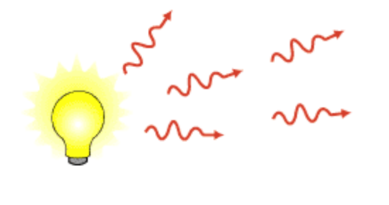
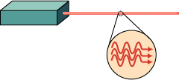




Difference between
Spontaneous Emission Stimulated Emission
Random emission
No control from outside
Not random process
Control from outside
Light is non-directional
Not monochromatic
Incoherent
No amplification
Less intensity
Unpolarized light
Highly directional
Nearly monochromatic
Coherent
Light amplification
More intensity
Polarized

Slide 16
Population Inversion and Pumping:
Usually , the number of atoms in the lower energy state is more than that in the excited state. According to Boltzmann, the ratio of atoms in the energy states 2 and 1 at a temperature T is given by
N₂
_{e} – E₂ / kT
=
_{e} – (E – E ) / kT
N
_{e} – E / kT ⁼
2 1
1
1
For population inversion : N₂ >> N₁ i.e.
N₂
E₂
N₂
E₂
N₁
E₁
N
1
E
1
Inverted State,
Non equilibrium condition N₂ >> N₁
Normal State,
Thermal equilibrium condition N₁>>N₂

Slide 17
The process of making population of atoms in the higher energy state more than that in the lower energy state is known as ‘population inversion’.
The method by which a population inversion is achieved is called ‘pumping’. In this process atoms are raised to an excited state by injecting into system photon of frequency different from the stimulating frequency.
Population inversion can be understood with the help of 3-energy level atomic systems.

Slide 18


E₃
Excited State
E₂
Meta Stable State
E₁
Ground State
Atoms
Atoms
E₃
Excited State
hν
hν hν
E
2
Meta Stable State
E₁
Ground State
Pumping
E₃
E₃
hν’
hν’
hν’
E₂
E
2
hν’
hν’
hν’
hν’
hν’
Atoms
Atoms
E
E₁
1
Rapid fall after 10⁻⁸ s
After Stimulated Emission

Slide 19





N
1
N
2
Thermal Equilibrium
N
3
E
1
E
2
E
3
N
Thermal Equilibrium
2
N
3
N
1
Population Inversion
Key: Bar represents the population of atoms
E
1
E
2
E
3
Population Inversion

Slide 20
Pumping:
A system in which population inversion is achieved is called an active medium. The method of raising a particle from lower state to higher energy state is called pumping.
Electrical Pumping: Atoms can be excited by electron impact in sufficiently intense gaseous discharge, known as electrical pumping. The electrical pumping is suited to gas and semiconductor lasers.
Optical Pumping: In this case atoms are excited by powerful lamp or a light source whose light populates excited states by photon absorption. This method is particularly suitable to solid state or liquid lasers.
Chemical Pumping: Here population inversion is achieved from an exothermic chemical reaction. Chemical pumping usually applies to material in the gas phase and it generally requires highly reactive and often explosive gas mixtures.

Slide 21
Three Components of Laser Devices: 1. The Pump:
It is an external source which supplies energy to obtain population inversion. The pump can be optical, electrical or thermal. In Ruby Laser, we use optical pumping and in He - Ne Laser, we use electric discharge pumping.
The energy supplied by the pump excites the atoms to higher energy levels and through spontaneous emission
or through non-radiative processes the population
inversion occurs.
III.The lifetime of the metastable energy state, in which
population inversion occurs must be very large as compared to the normal life time of the excited atom in any other energy state.

Slide 22
2. The Laser Medium: It is material in which the laser action is made to take place. It may be solid, liquid or gas. The very important characteristic requirement for the medium is that inversion should be possible in it.
Many lasers are named after the material used.
For Example: Solid Sate Laser: The output of Ruby laser is at
694.3 nm; Gas Lasers: In He-Ne laser the output is at
632.8 nm.
Note: Laser action has been observed in more than half of the
known atoms and laser wavelength may extend
from The most the laser
ultraviolet region to the infra-red region. important characteristic requirement for
medium is that we should be able to obtain the population inversion in it.

Slide 23
3. The Resonator: It consists of a pair of plane or spherical mirrors having common principal axis. The reflection coefficient of one of the mirrors is very near to 1 and that of the other is kept less than 1. The resonator is basically a feed-back device, that directs the photons back and forth through the laser medium and in the process, the number of photons is multiplied due to stimulated emission.

Slide 24
LASER COMPONENTS
Optical Resonator
Output Beam
Active Medium
HIgh Reflectance Mirror (HR)
Half Silvered Mirror
Excitation
Mechanism Or pump

Slide 25
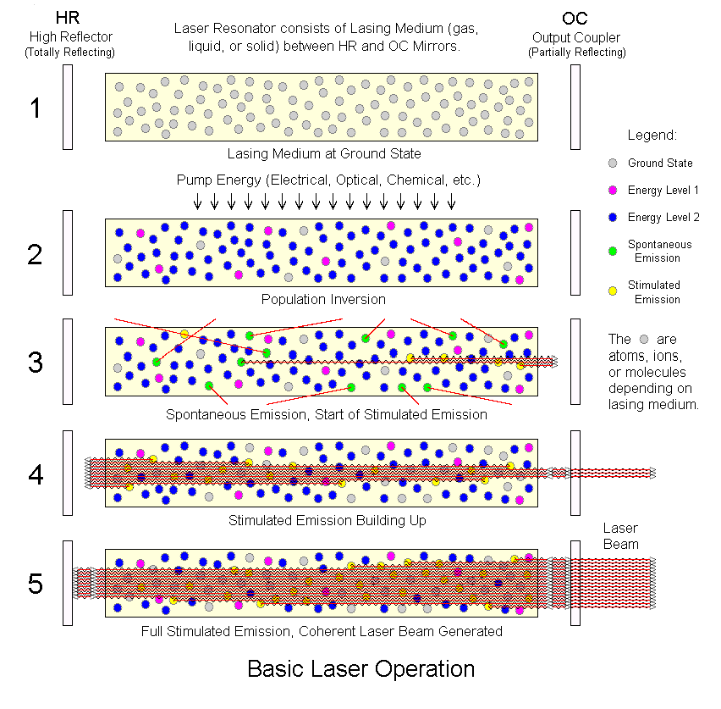
25

Slide 26
Principle of Laser:
An atomic system having one or two meta-stable states is chosen. Normally, the number of atoms in the lower energy state is greater than that in the meta-stable state.
This population is inverted by a technique known as pumping.
The atoms are made to fall from meta-stable state to lower energy state and photons are emitted by stimulated emission.
The photons are reflected back and forth in the active medium to excite the other atoms.
Thus a large number of photons are emitted simultaneously which possess the same energy, phase and direction. This process is called ‘amplification of light’.
To produce laser beam, the following two conditions must be fulfilled:
The meta-stable state should all the time have larger number of atoms than the number of atoms in lower energy state.
The photons emitted due to stimulated emission should stimulate other atoms to multiply the photons in the active medium.

Slide 27
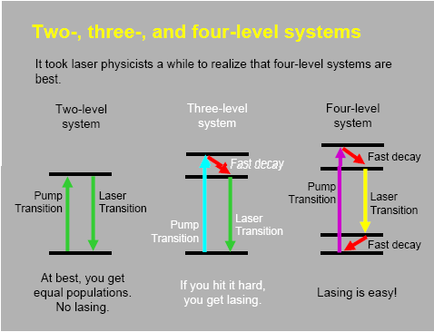
9/6/2017

Slide 28



Three level Laser
Excited State
Spontaneous Energy Emission
Step: 2
Metastable State
Energy Introduction
Stimulated
Emission of Radiation
Step: 3
Step: 1
Ground State

Slide 29

















Four level Laser
Laser Process can be divided into four steps
E₃
Stimulated Absorption
Step: 2
E₂
Spontaneous Emission
Pumping
Step: 3
Stimulated Emission
Step: 1
E₁
Step: 4
Spontaneous Emission
E₀
Ground Level
Meta Stable Energy Level

Slide 30
Different Lasers
Classification in number of ways:
According to the state of laser medium: Gas, Liquid and Solid Laser.
According to the type of pumping: Flash light, Chemical Action, and Electric Discharge Lasers
According to the nature of output: Pulsed (P) or Continuous Wave (CW) Lasers
Classification on the basis of Spectral region of the light: Ultra-Violet, Visible or Infra-Red Lasers.

Slide 31
Ruby Laser
He-Ne laser
Semiconductor Laser (Diode Laser)

Slide 32
Ruby Laser
The first laser was created in 1961 by T. Maiman.
It is solid state laser (solid state laser means the laser in which the active medium is solid)
He used a rod of ruby as the active (lasing) medium.
Ruby is basically Aluminum Oxide (Al₂O₃) crystal in which a small part of Aluminum (about 0.05% to 0.1%) is replaced with ions of Cr³⁺.
Chromium atom play the active role for laser action and aluminum and oxygen atoms remain inert .

Slide 33
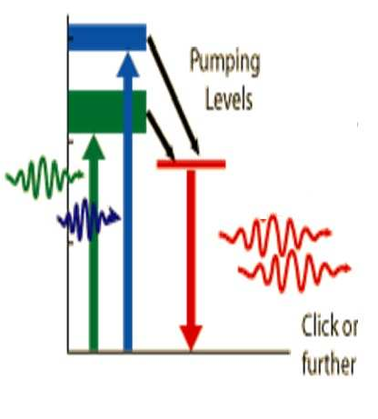
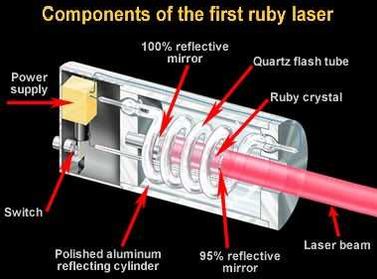
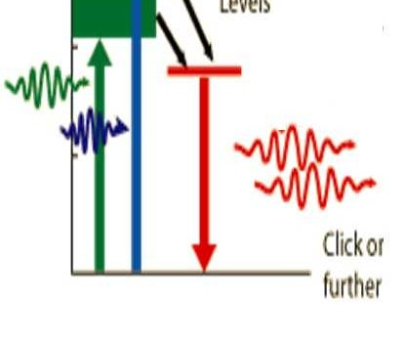
Chromium ions have absorption bands in the blue and green regions
Ruby rod is taken in the form of cylindrical rod of about 4cm in length and 1cm in diameter
The end faces of the ruby rod are silvered so that they form the optical resonator

Slide 34




The ruby rod is illuminated by an intense impulse of light, which is generated by a helical xenon flash lamp.
Xenon flash light tube
Resonanat cavity
The ends of the ruby rod are highly polished and silvered to serve as laser mirrors.

Slide 35
Cont…
After receiving a pumping from the xenon flash tube, the laser light emerges for as long as the excited atoms persist in the ruby rod, which is typically about a millisecond.
In order for stimulated emission to exceeds stimulated absorption, more than half of the
_{Cr}3+
ions of the ruby rod must be in the
metastable state.
The energy levels of Cr3+ that are important for the operation of a ruby laser are shown below:

Slide 36
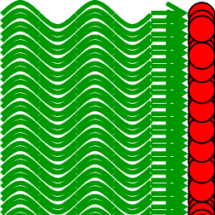


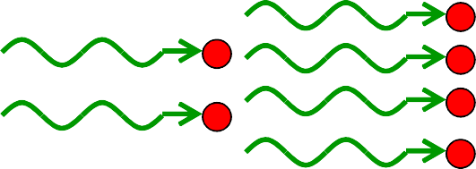
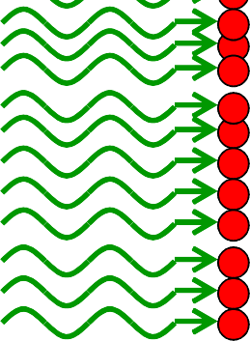
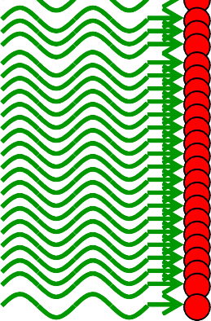
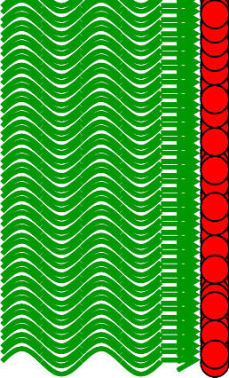

LIGHT AMPLIFICATION

Slide 37
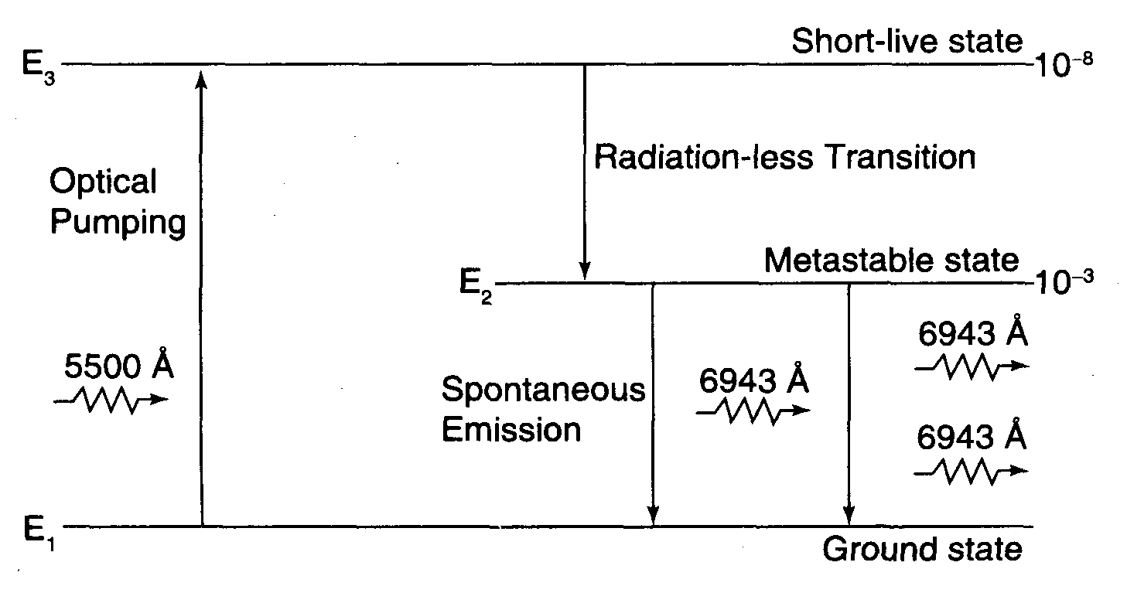
Fig. 4.10

Slide 38
SALIENT FEATURES
Uses three level pumping scheme
The active centers are Cr³⁺ ions
Its output is 6943 Å (i.e. =694.3 nm)
Its output lies in visible (red part) spectrum.
Light from a Xenon flash lamp is the pumping agent
Poor efficiency
Operates in pulsed mode

Slide 39
DRAWBACKS OF RUBY LASER
Pulsed or spiked output which is a characteristic of three level laser system.
Large fraction of pumped energy is lost as heat in the active medium. This loss can be due to thermal scattering
of photons caused by imperfections or vacancies to vigorous lattice vibrations.
Is always associated with bulky cooling system.
or due

